Slide 1
1D Thermo-elastic Contact
Chuyun Guan
Abdul Khalid
Faisal Raja
Ashish Rana
Run Si
Bret Wainwright

Slide 2

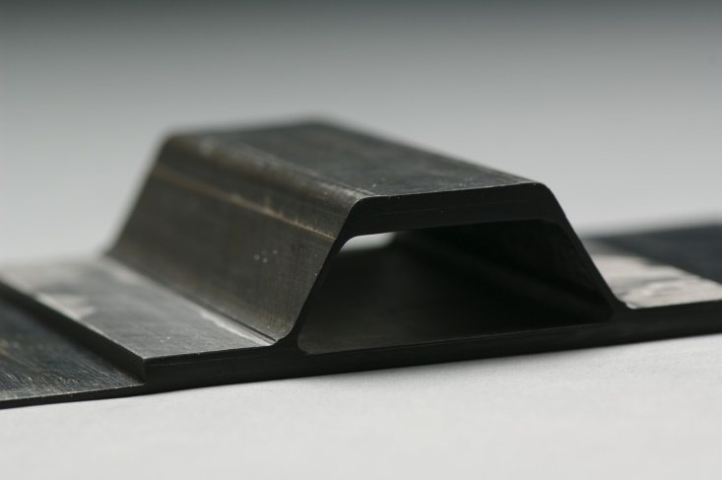
Background
Interest in aerospace industry to design very high speed high (Mach 5+) in atmosphere aircraft
Conditions lead to both large forces and temperatures that must be accounted for.
One issue is intermittent contact between substructures in conjunction with these high temperatures (whether caused by thermal expansion, mechanical vibration, or both).
Example: Hat Stiffened Panel
Other applications of this kind of thermo-elastic contact including nuclear reactor cooling and electronics.
Notes:
There has been recent interest in aerospace industry to design aircraft meant for very high speeds(Mach 5+) and high altitudes.
This brings with it large forces and temperatures which need to properly accounted for in design and analysis.
One potential issue is intermittent contact between substructures in conjunction with these high temperatures (whether caused by thermal expansion, mechanical vibration, or both).
Example: Hat Stiffened Panel
Other applications of this kind of thermo-elastic contact including nuclear reactor cooling and electronics.

Slide 3
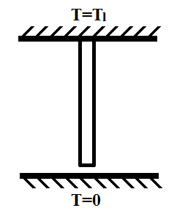
Challenges
Idealized boundary conditions can lead to intractable solutions
Even in simple 1D problems, questions of the existence, uniqueness and stability can arise.
Solution proposed by Barber is introduce a thermal contact resistance that is dependent on contact pressure
Fully coupled transient heat transfer and structural problem, loosely coupled steady state problem.
L
g_{o}

Slide 4
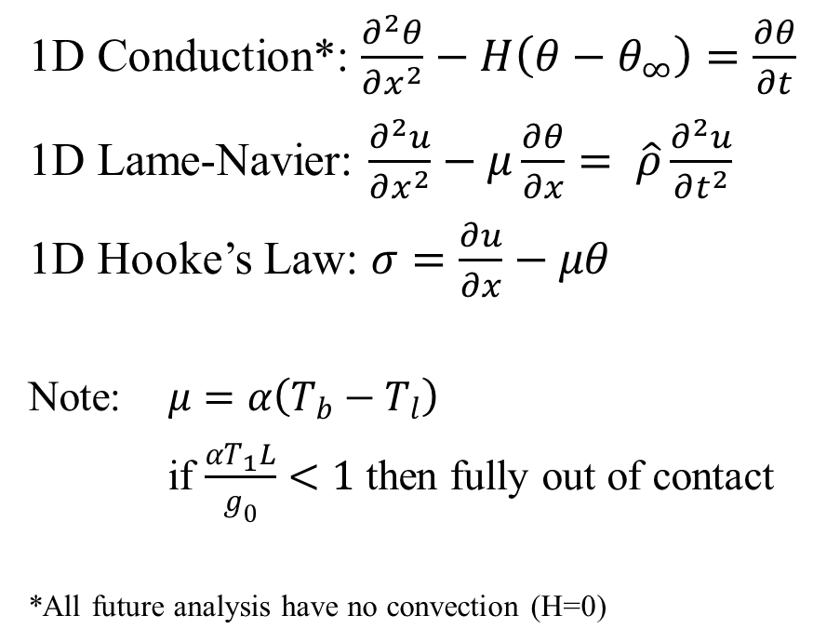
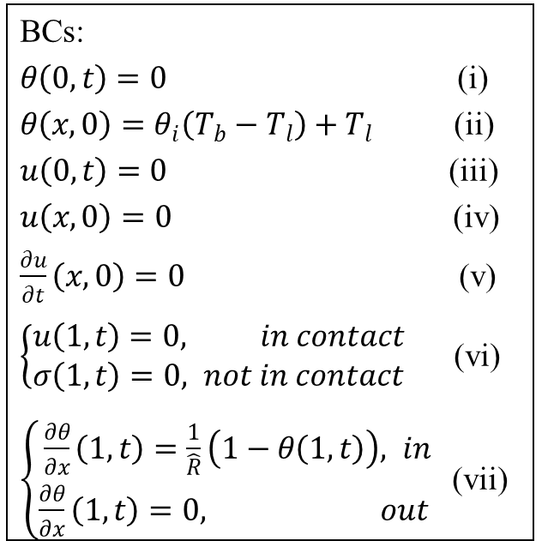
Formulation
The non-dimensional transient equations were derived from energy and force balance for the 1D rod.
1D Conduction*: $\frac{∂^{2}θ}{∂x^{2}}−H\left(θ−θ_{∞}\right)=\frac{∂θ}{∂t}$
1D Lame-Navier: $\frac{∂^{2}u}{∂x^{2}}−μ\frac{∂θ}{∂x}= \hat{ρ}\frac{∂^{2}u}{∂t^{2}}$
1D Hooke’s Law: $σ=\frac{∂u}{∂x}−μθ$
Note: $μ=α\left(T_{b}−T_{l}\right)$
if $\frac{αT_{1}L}{g_{0}}<1$ then fully out of contact
*All future analysis have no convection (H=0)
BCs:
$θ\left(0,t\right)=0$ (i)
$θ\left(x,0\right)=θ_{i}\left(T_{b}−T_{l}\right)+T_{l}$ (ii)
$u\left(0,t\right)=0$ (iii)
$u\left(x,0\right)=0$ (iv)
$\frac{∂u}{∂t}\left(x,0\right)=0$ (v)
$\left\{\begin{aligned}u\left(1,t\right)=0, in contact \\ σ\left(1,t\right)=0, not in contact\end{aligned}\right.$ (vi)
$\left\{\begin{aligned}\frac{∂θ}{∂x}\left(1,t\right)=\frac{1}{\hat{R}}\left(1−θ\left(1,t\right)\right), in \\ \frac{∂θ}{∂x}\left(1,t\right)=0, out \end{aligned}\right.$ (vii)

Slide 5
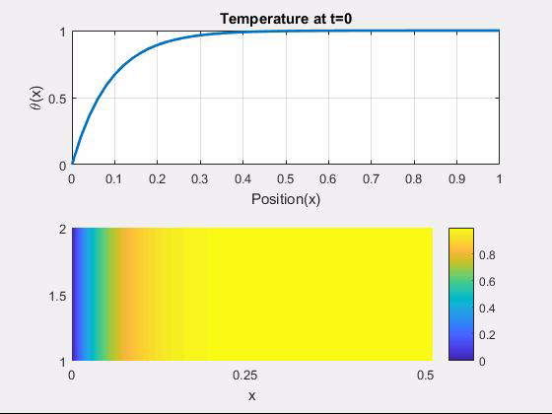

Transient Solutions (No R)
A first a transient analysis was performed looking rod in full contact with no thermal resistance:
Next the transient analysis was done for the rod out of contact (this is irrespective of R)

Slide 6
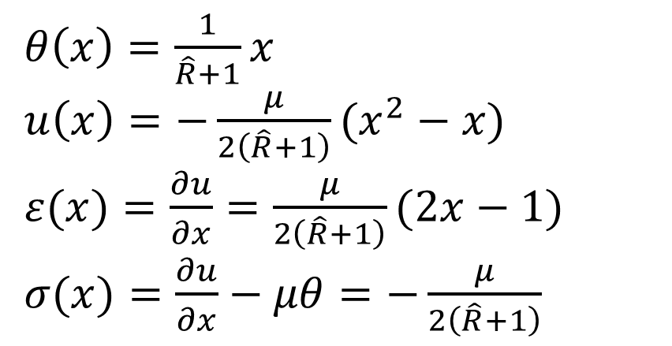
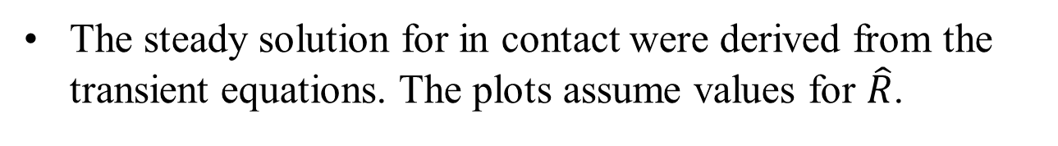
Steady Solutions
The steady solution for in contact were derived from the transient equations. The plots assume values for $\hat{R}$.
$θ\left(x\right)=\frac{1}{\hat{R}+1}x$
$u\left(x\right)=−\frac{μ}{2\left(\hat{R}+1\right)}(x^{2}−x)$
$ε(x)=\frac{∂u}{∂x}=\frac{μ}{2\left(\hat{R}+1\right)}(2x−1)$
$σ(x)=\frac{∂u}{∂x}−μθ=−\frac{μ}{2\left(\hat{R}+1\right)}$

Slide 7
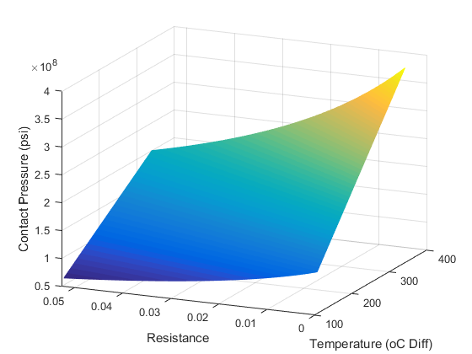
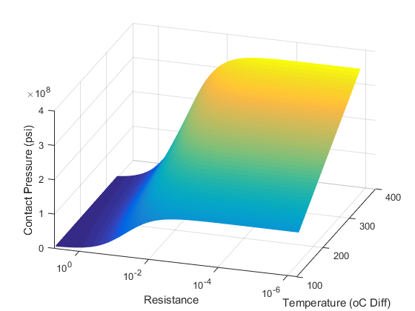
Resistance-Pressure Correlations
In the steady problem the time dependence of the contact pressure and contact resistance is ignored, so their correlation can be plotted.
In the transient case, a function for the thermal resistance is necessary to close the loop, as the resistance is a function of contact pressure which is a function of resistance.
From literature, it is generally assumed resistance decreases with contact pressure. The function must intersect with the surface.

Slide 8
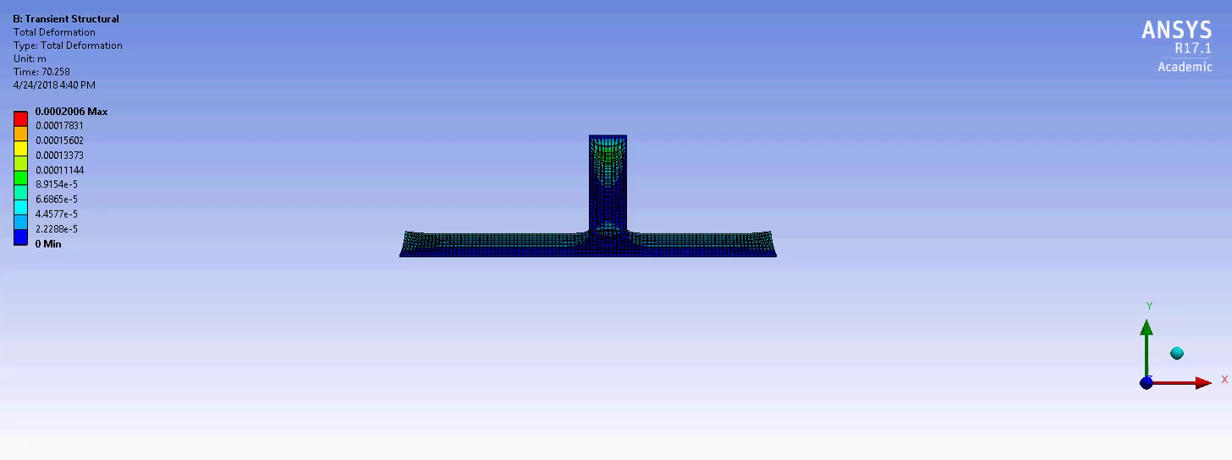
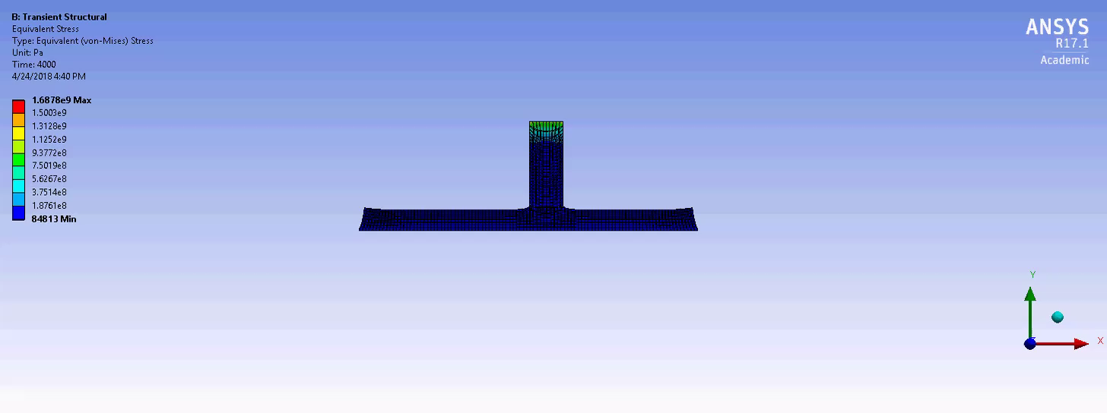
Numerical simulation
Fixed supports on top and bottom
Frictional contact with 0.6 as friction (R value)
Gap distance constant

Slide 9
Conclusions
Stress is constant throughout the 1D rod
The steady state temperature is linear throughout the rod when in contact, and is flat when the rod is out of contact.
Steady state displacements throughout the rod are quadratic and negative, with the minimum at the center of the rod.
Contact resistance is difficult to evaluate, as it should be a function of contact pressure, which varies in time. This function would be necessary to solve the transient fully coupled problem.

Slide 10
References
^{[1]} Ahn., J., Clark, N., “Mathematical and Numerical Approaches to a One-dimensional Dynamic Thermoviscoelastic Problem”, Nonlinear Analysis: Real World Applications, 2014, pp. 437-451.
^{[2]} Alonso, M. P., Garrido, J. A., Foces, A., “Application of BEM to Solve Two-Dimensional Thermoelastic Contact Problem with Convection and Radiation Conditions”. Computers & Structures. Vol 66. pp 115-125.
^{[3]} Barber, J. R., Dundurs, J. ,Comninou, M., “Stability Considerations in Thermoelastic Contact. Journal of Applied Mechanics, Vol. 47, 1980, pp. 871-874.
^{[4]} Barber J.R., “Thermoelasticity and Contact.” Journal of Thermal Stresses, Vol 22, 1999, pp 513-525.
^{[5]} Barber, J. R. , Zhang, R. , “Transient Behavoir and Stability for the thermoelastic contact of two Rods of Dissimilar Materials.” International Journal of Mechanical Science, Vol. 30, 1988, pp. 691-704
^{[6]} Comninou, M. , Dundurs, J. “On Boundary Conditions In Contact Problems With Heat Conduction.”, Developments In Theoretical And Applied Mechanics, Vol. 8, 1976
^{[7]} Comninou, M. , Dundurs, J. “ On the Barber Boundary Conditions for Thermoelastic Contact. Journal of Applied Mechanics, Vol. 46, 1979, pp. 849-853.
^{[8]} Comninou, M., Dundurs, J. “On Lack of Uniqueness in Heat Conduction through a Solid to Solid Contact. Journal of Heat Transfer, Vol. 102, 1980, pp. 319-323.
^{[9]} Comninou, M., Dundurs, J., Barber, J. R., “Planar Hertz Contact With Heat Condition”, Journal of Applied Mechanics, Vol. 48, 1981, pp. 549-554.
^{[10]} Comninou, M., Barber, J. R., Dunders, J. “Heat Conduction Through a Flat Punch”. Journal of Applied Mechanics, Vol. 48. 1981, pp. 871-875
^{[11]} Comninou, M. , Barber, J. R., “The Thermoelastic Hertz Problem With Pressure Dependent Contact Resistance”. International Journal of Mechanical Science, Vol 26, 1984, pp 549-554.
^{[12]} Espinosa, V. , Foces, A. “Boundary Elemental Method Applied to Three Dimensional Thermoelastic Contact”. Engineering Analysis with Boundary Elements, 2012, pp. 928-933
^{[13]} Kishimoto, K., Inoue, H., Shibuya, T., “Boundary element analysis of thermoelastic contact problems”. Engineering Analysis with Boundary Elements, 1995, pp. 329-337
^{[14]} Pelesko, J. A. ,”Nonlinear Stability, Thermoelastic Contact, and the Barber Condition”. Journal of Applied Mechanics, Vol 68, pp. 28-33
^{[15]} Shi, P., Shillor, M., Zou, X. L., “Numerical Solutions to One-Dimensional Problems of Thermoelastic Contact”. Computers Mathematical Applications, Vol 22, 1991, pp 65-78

Slide 11
Thank you!

